Slide 1

Capstone Project - HealthCare Insurance

Slide 2
Proposed Requirements
Purpose - understand the customers and tailor the customized offers for them to potentially increase the revenue.
Data Sources - Competitors company data - scrapping and third-party sources.
Role as DE – Analyse the data and track it to enhance the company’s revenue

Slide 3
Approach & Tools used
JIRA
AWS S3
Databricks
AWS Redshift
PySpark
Spark SQL
Github

Slide 4
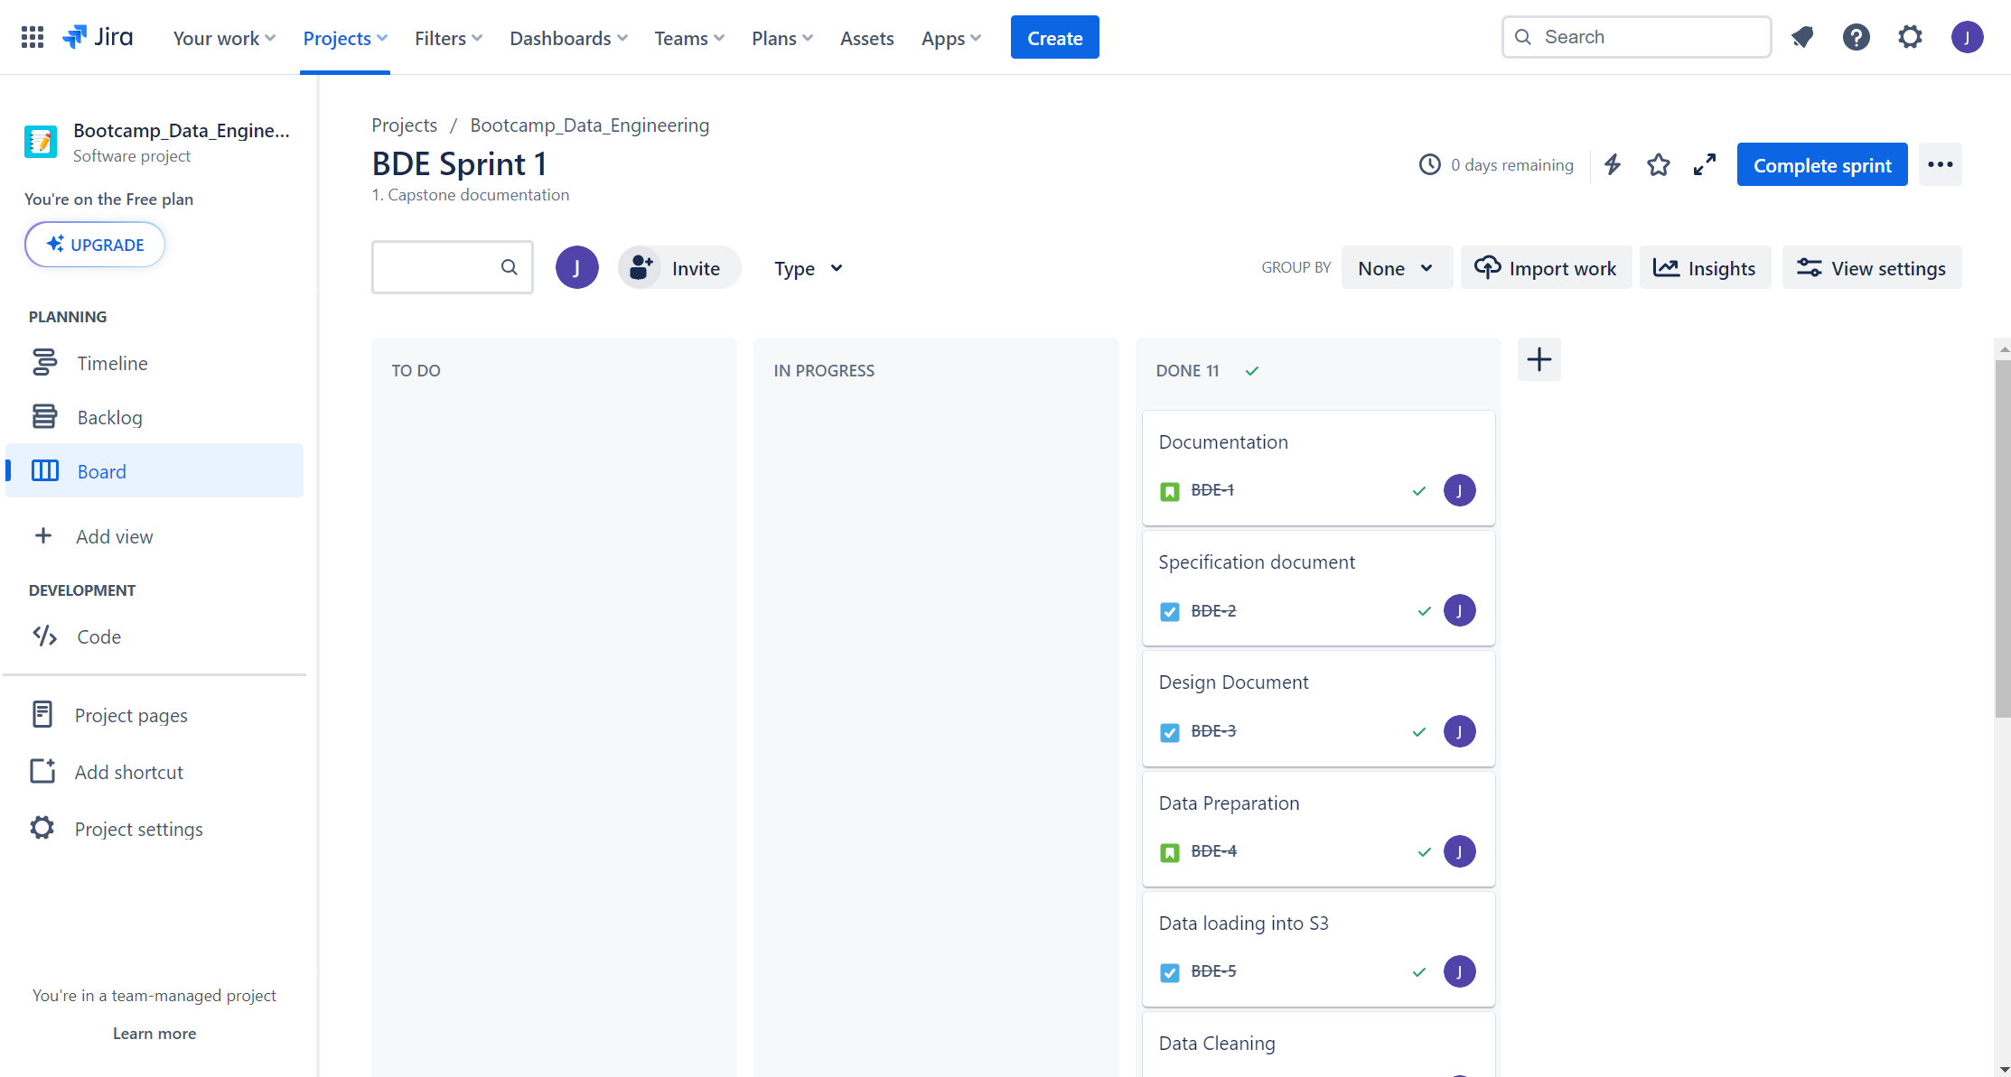
JIRA – Managing Project stages
Created User stories and Tasks
Tracked project status
Used 2 sprints for the entire execution

Slide 5
Documentation
Specification Requirements Document
Solution Design Document

Slide 6
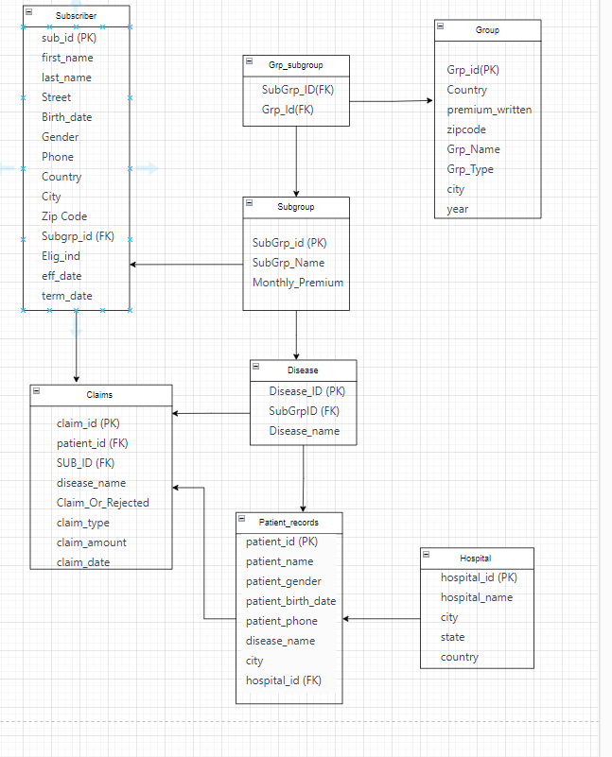
ERD
Tables with PK,FK
Relationships linked

Slide 7

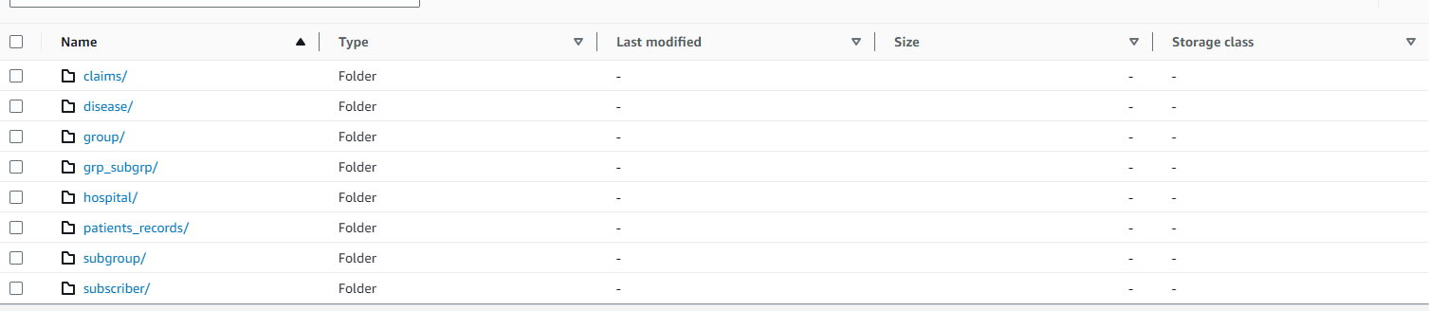
Data Extraction

Slide 8
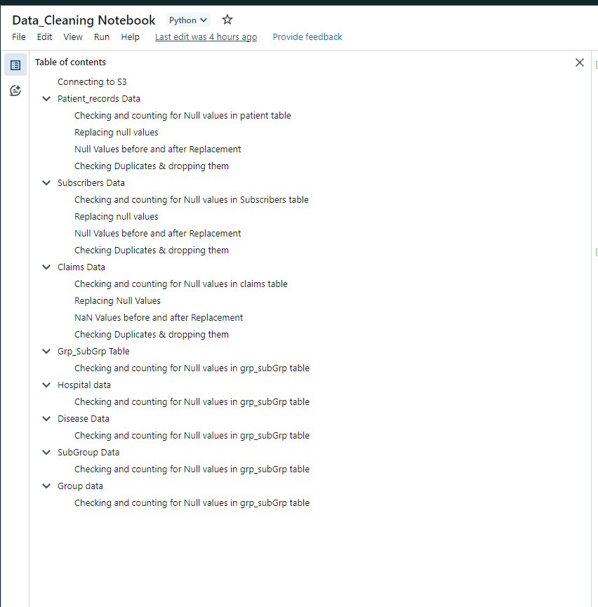
Data Preparation
Data Cleaning and enrichment
Followed four basic steps
Validated data

Slide 9
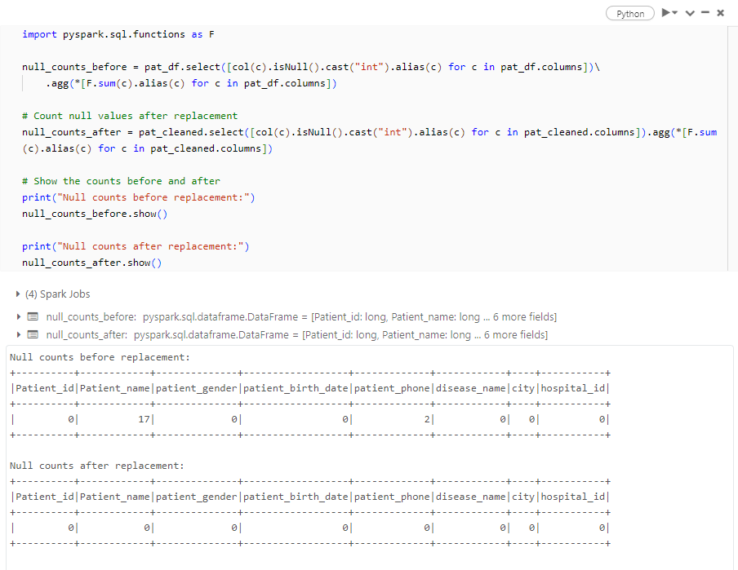
Data validation
Used code to validate the data was correct and accurate
Checked Correctness
Validated successfully

Slide 10

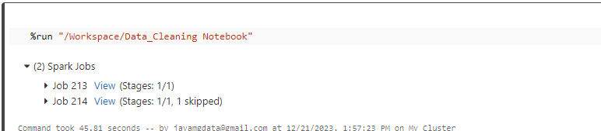
Result Generation

Slide 11
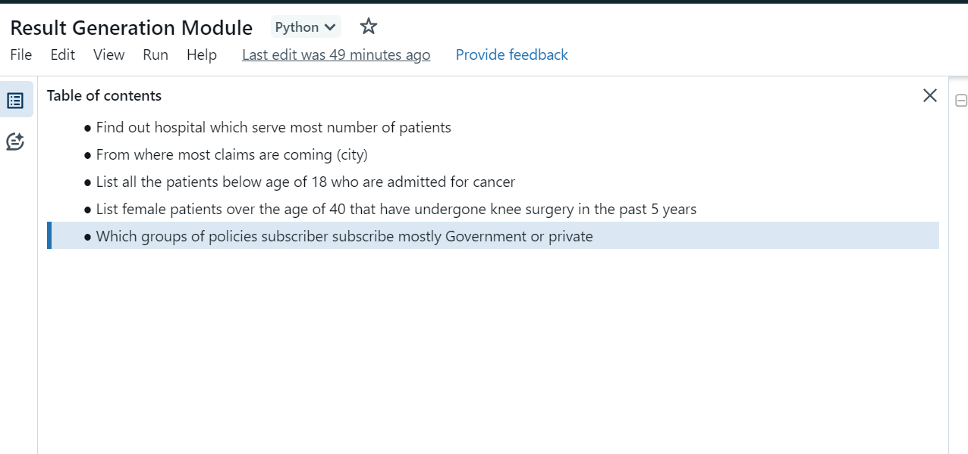
Usecases Solved

Slide 12
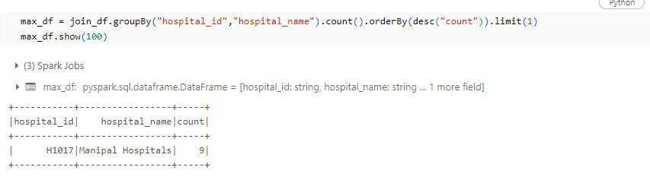
Find out hospital which serve most number of patients

Slide 13
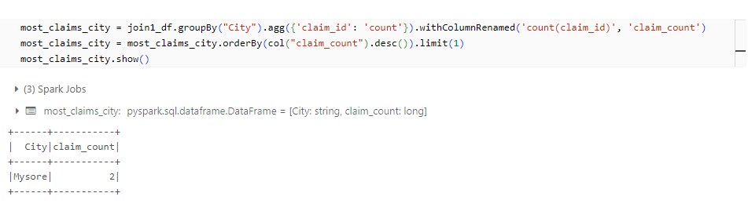
From where most claims are coming (city)

Slide 14
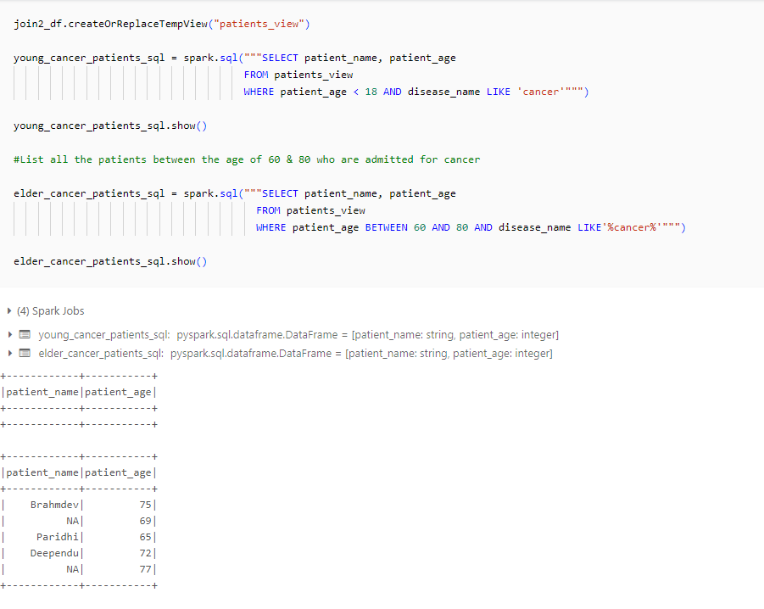
List all the patients below age of 18 who are admitted for cancer

Slide 15
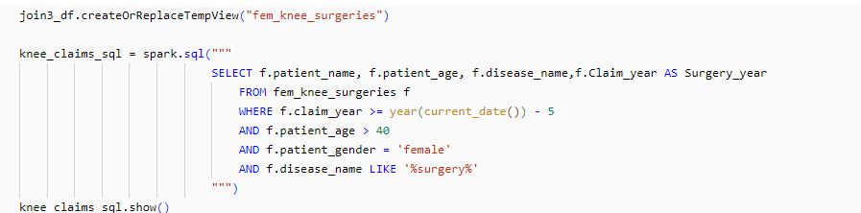
List female patients over the age of 40 that have undergone knee surgery in the past 5 years
Created Age column
Exracted year from claim_date

Slide 16
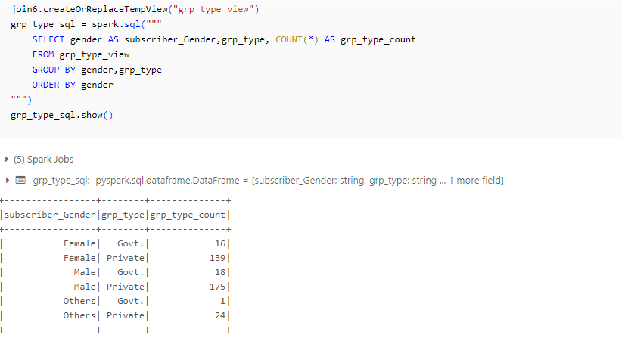
Which groups of policies subscriber subscribe mostly Government or private

Slide 17
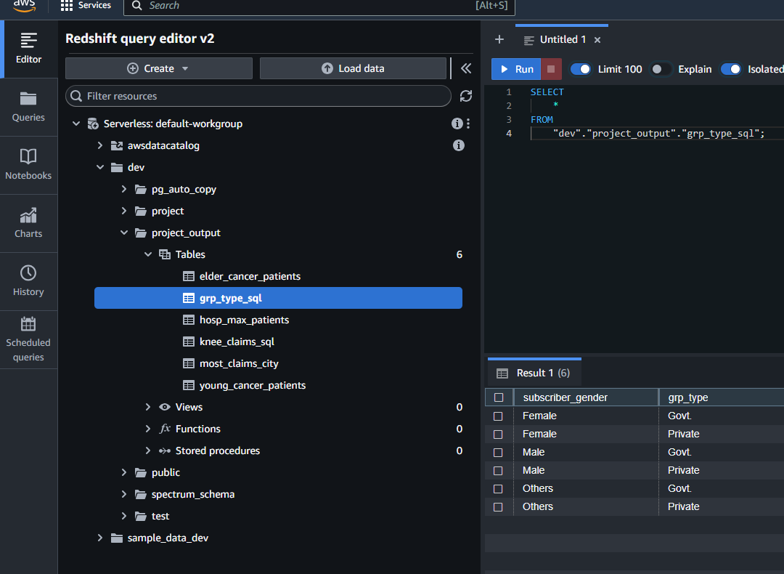

Loading the tables
Under Schema – project_output

Slide 18
Github Integration
CI/CD
Future changes
Facilitating XFN collaboration
https://github.com/Jayaprathag/Bootcamp

Slide 19
Key metrics tracked
Demographic insights
Behavioral insights
Geographical insights

Slide 20
Thank you !!!

